Slide 1

Master Thesis by : Viplav Setia
Mat.-Nr. : 31617
Is ROS2 suitable for Automotive Embedded Systems & Real Time Use
Supervisors :
Hochschule Ravensburg Weingarten:
Prof. Dr. Ing. Benedikt Reick
Prof. Dr. rer. nat. Markus Pfeil
ALTEN GmbH:
Mr. Thomas Langer
Mr. Philipp Käshammer
Notes:
Hinterlasse hier Informationen zum Inhalt. So können auch andere diese Folie besser verstehen.
Hier steht ein Text zum Inhalt.

Slide 2
Master Thesis Timeline
Mid-Review
Tasks | August | September | October | November | December | January
Literature Research & Software Base
ADAS Demonstrator based on ROS2 in Virtual System Environment
Demonstrator of micro-ROS on Micro Controller Unit(mR-MCU)
mR-MCU HW Environment : Stepper Motor/LEDs/Pressure Sensor
Real Time Performance Indicator Research and Development
Real Time Testing
mR-MCU HW Environment: Transfer Images from Camera (Optional)
Documentation
Notes:
Hinterlasse hier Informationen zum Inhalt. So können auch andere diese Folie besser verstehen.
Hier steht ein Text zum Inhalt.

Slide 3
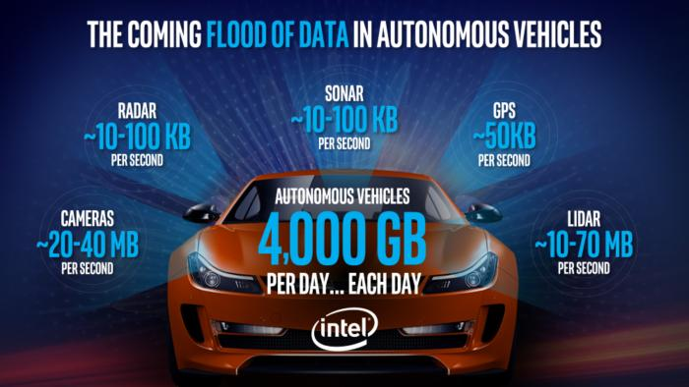
What is ROS?
Robot Operating System
Open source meta operating system which has tools, libraries for complex and robust robot control
Wide variety of use cases
Community interface between processes using device drivers, visualizers, etc.
Offers message passing system via publisher/subscription mechanism
Image Source : B.Krzanich, Data is the new oil in the future of automated driving
https://newsroom.intel.com/editorials/krzanich-the-future-of-automated-driving/#gs.5pqy7i
Notes:
Hinterlasse hier Informationen zum Inhalt. So können auch andere diese Folie besser verstehen.
Hier steht ein Text zum Inhalt.

Slide 4
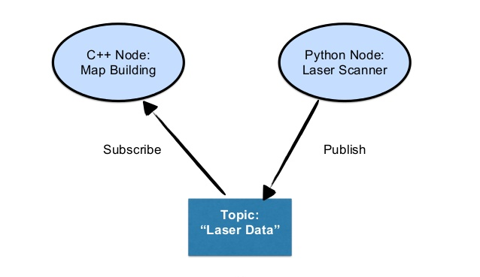
Important Definitions
Node: An executable/application that runs a program/subprogram that communicate with each other via streaming topics.
Topic: is a named bus over which nodes exchange messages.[1]
Message: is a data structure, eg – integer, floating point, boolean,etc.
Data Distribution Service(DDS): is a middleware standard to ensure dependable,high performance, inter-operable,real time data exchanges.[2]
Discovery: The automatic process through which nodes determine how to talk to each other.[3]
Source :
1. Open Source Robotics Foundation, http://wiki.ros.org/Topics
2. Seungmin Park et. al., An DDS based Architecture in Supporting of Data Centric Wireless Sensor Network Environments
3.Open Source Robotics Foundaition https://index.ros.org//doc/ros2/Concepts/Overview-of-ROS-2-concepts/
Image source : https://www.slideshare.net/ArnoldBail/robotics-and-ros
Notes:
Hinterlasse hier Informationen zum Inhalt. So können auch andere diese Folie besser verstehen.
Hier steht ein Text zum Inhalt.

Slide 5
Why ROS2
Real Time
Embedded boards
New Use Cases
Language Independence
& Code Reuse
Non-ideal
Transport Networks
DDS
Zero configuration
New Technologies
Microsoft Windows Support
Node Lifecycle &
Deterministic Launch
Notes:
Hinterlasse hier Informationen zum Inhalt. So können auch andere diese Folie besser verstehen.
Hier steht ein Text zum Inhalt.

Slide 6
DDS QoS Policies
History
Keep last: only store up to N samples, configurable via the queue depth option.
Keep all: store all samples, subject to the configured resource limits of the underlying middleware.
Depth
Size of the queue: only honored if used together with “keep last”
Reliability
Best effort: attempt to deliver samples, but may lose them if the network is not robust.
Reliable: guarantee that samples are delivered, may retry multiple times.
Durability
Transient local: the publisher becomes responsible for persisting samples for “late-joining” subscribers.
Volatile: no attempt is made to persist samples.
By default, publishers and subscribers are reliable in ROS 2, have volatile durability, and “keep last” history.[1]
Source :
1. Open Source Robotics foundation , About Quality of Service Settings, https://index.ros.org/doc/ros2/Concepts/About-Quality-of-Service-Settings/
Notes:
Hinterlasse hier Informationen zum Inhalt. So können auch andere diese Folie besser verstehen.
Hier steht ein Text zum Inhalt.

Slide 7
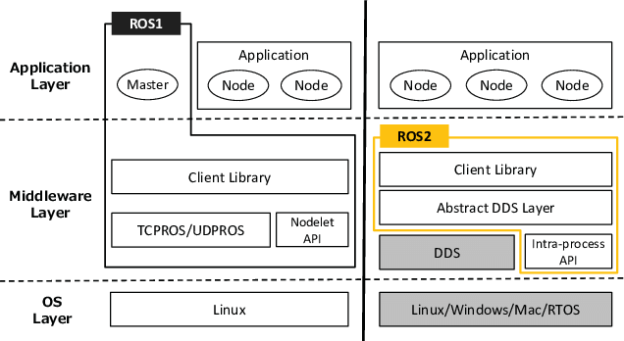
ROS1 vs ROS2
C/C++/Python
FastRTPS,RTI Connext, Opensplice
Nuttx
Image Source : Maruyama, Yuya & Kato, Shinpei & Azumi, Takuya. (2016). Exploring the performance of ROS2. 1-10. 10.1145/2968478.2968502.
Notes:
Hinterlasse hier Informationen zum Inhalt. So können auch andere diese Folie besser verstehen.
Hier steht ein Text zum Inhalt.

Slide 8
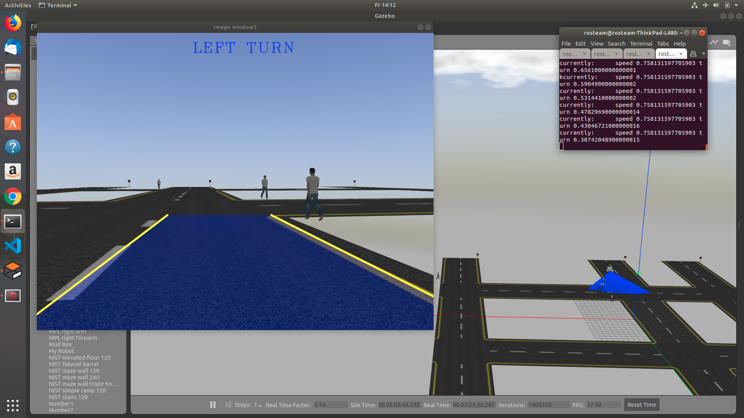

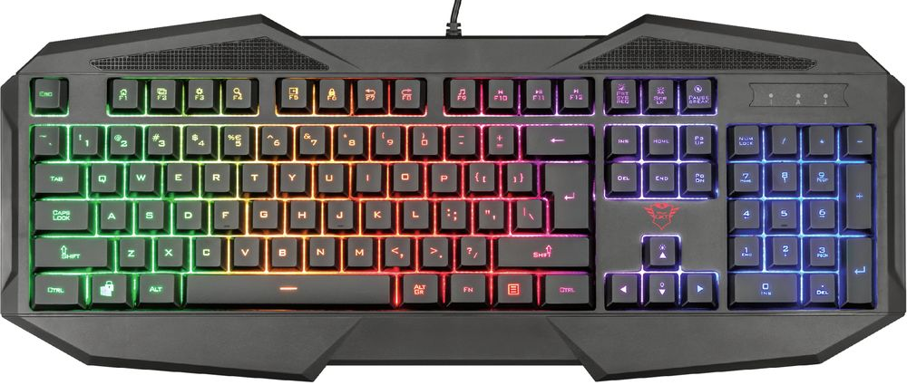
Implementing ROS2 for ADAS
OpenCV raw Image
Lane Assist Node
Camera Plugin
ROS Image
Differential Drive Plugin
User
Robot Simulator
LIDAR Plugin
Range
Obstacle Avoidance Node
Linear velocity(x)
Angular velocity(z)
Linear velocity(x) = 0
Angular velocity(z) = 0
Teleop Keyboard Node
Notes:
Hinterlasse hier Informationen zum Inhalt. So können auch andere diese Folie besser verstehen.
Hier steht ein Text zum Inhalt.

Slide 9
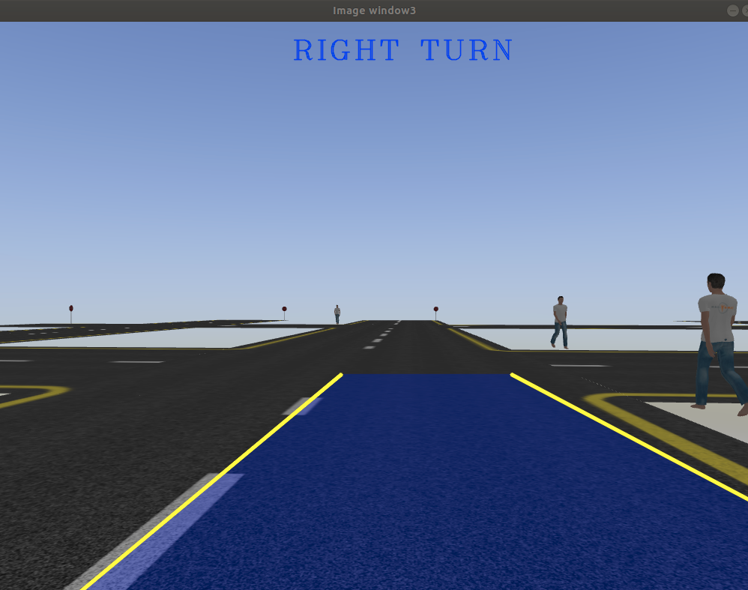
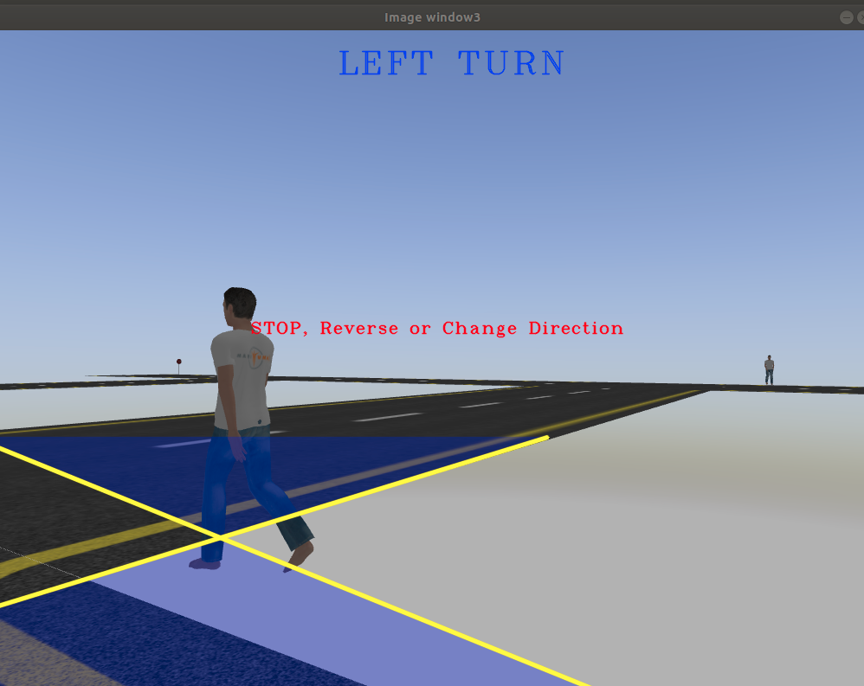
Implementing ROS2 for ADAS
Notes:
Hinterlasse hier Informationen zum Inhalt. So können auch andere diese Folie besser verstehen.
Hier steht ein Text zum Inhalt.

Slide 10
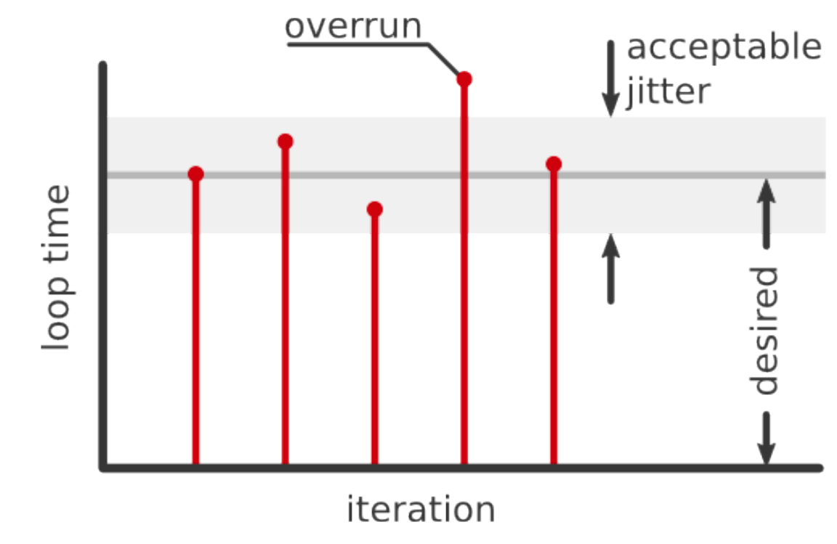
Real Time
It's about determinism, not performance
Correct computation delivered at the correct time
Failure to respond is as bad as a wrong response
Usefulness of result after missing deadline?[1]
Soft
Real Time
Hard
Firm
Source :
1. J. Kay, A. R. Tsouroukdissian, "Real-time control in ROS and ROS 2.0", ROSCon15, 2015
Notes:
Hinterlasse hier Informationen zum Inhalt. So können auch andere diese Folie besser verstehen.
Hier steht ein Text zum Inhalt.

Slide 11
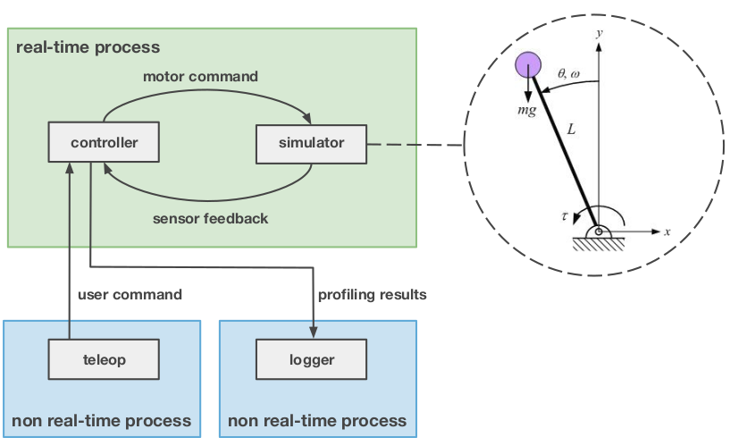
Is ROS2 Real Time?
ROS2 Alpha release is configurable to be real-time[1]
DDS offers soft real time capability by customising QoS
Testing done by Inverted pendulum demo
Results are encouraging[1]
ROS2 Dashing Diameta : Intra-process communication (C++ only) has been improved - both in terms of latency as well as minimizing copies[2]
standard rclcpp(C++) Executor is not deterministic and doesn’t guarantee real time[3]
ROS2 will allow real time applications with a proper
RTOS and carefully written user code
Apex.AI has created automotive grade ROS2 Apex.OS
with ISO 26262 certification
Inverted Pendulum Demo[1]
Source :
1. J. Kay, A. R. Tsouroukdissian, "Real-time control in ROS and ROS 2.0", ROSCon15, 2015
2. Open Source Robotics Foundation, ROS2 Dashing Diameta https://index.ros.org//doc/ros2/Releases/Release-Dashing-Diademata/
3.Real Time Executor,
https://micro-ros.github.io//docs/concepts/client_library/real-time_executor/
Notes:
Hinterlasse hier Informationen zum Inhalt. So können auch andere diese Folie besser verstehen.
Hier steht ein Text zum Inhalt.

Slide 12
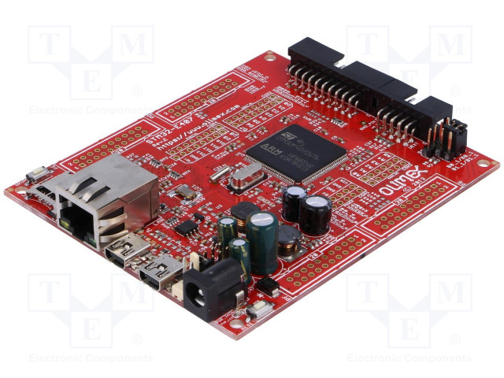
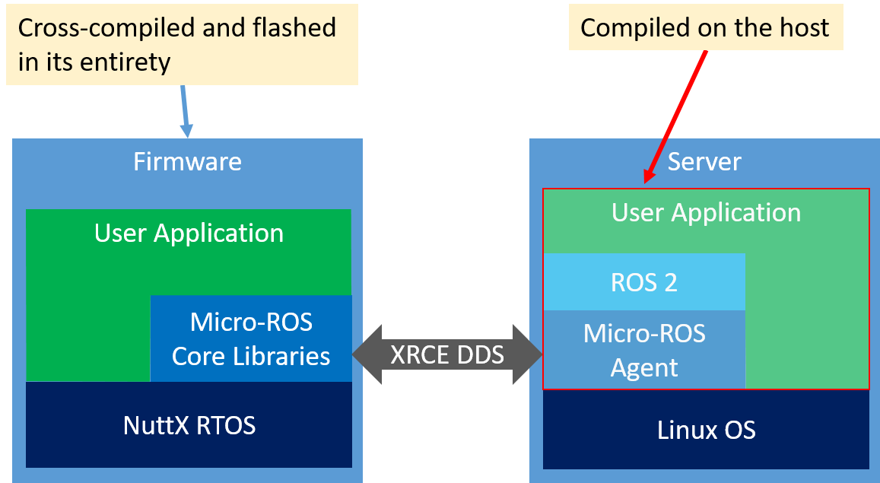
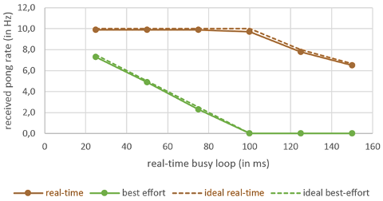
Micro-ROS
Has it’s own Real Time LET(Logical Execution Time) Executor(C Language only)
Low Resource Consumption
Multi-Transport Support (Serial/UDP/TCP)
Ping Pong Test Bench with Linux RT_PREEMPT by Developers show Real Time Behaviour
Under Heavy Development & Limited Functionality
Olimex STM32 Embedded Board[1]
Micro-ROS Benchmarking[3]
Micro-ROS Architecture[2]
Image Source :
1. https://www.tme.eu/ch/details/stm32-e407/entwicklungsboards-fur-stm-schaltungen/olimex/
2.Micro-ROS-Setup https://github.com/micro-ROS/micro-ros-build/tree/crystal/micro_ros_setup
3.Real Time Executor, https://micro-ros.github.io//docs/concepts/client_library/real-time_executor
Notes:
Hinterlasse hier Informationen zum Inhalt. So können auch andere diese Folie besser verstehen.
Hier steht ein Text zum Inhalt.

Slide 13
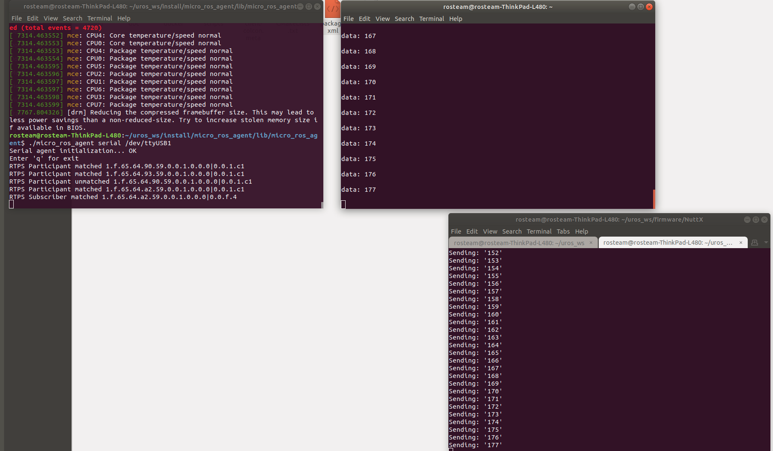
Micro-ROS Demo
ROS2 subscriber@ Linux
Micro-ROS Agent@ Linux
Micro-ROS publisher@Nuttx
Notes:
Hinterlasse hier Informationen zum Inhalt. So können auch andere diese Folie besser verstehen.
Hier steht ein Text zum Inhalt.

Slide 14
Next Steps
Mid-Review
Tasks | August | September | October | November | December | January
Literature Research & Software Base
ADAS Demonstrator based on ROS2 in Virtual System Environment
Demonstrator of micro-ROS on Micro Controller Unit(mR-MCU)
mR-MCU HW Environment : Stepper Motor/LEDs/Pressure Sensor
Real Time Performance Indicator Research and Development
Real Time Testing
mR-MCU HW Environment: Transfer Images from Camera (Optional)
Documentation
Updated software,new packages
Add Navigation, SLAM,Next Level, Data Logging?
C++ Executor might be released
Self - development
Inverted pendulum demo changing DDS, QoS
Self - development
Notes:
Hinterlasse hier Informationen zum Inhalt. So können auch andere diese Folie besser verstehen.
Hier steht ein Text zum Inhalt.

Slide 15
Questions/Feedback
Thank you
Tracer add
Timestamping
Physical test?
Algorithm real time test
Problems and decisions
Notes:
Hinterlasse hier Informationen zum Inhalt. So können auch andere diese Folie besser verstehen.
Hier steht ein Text zum Inhalt.

Slide 16
Real Time Discussion
Ping Pong node & Tracing : adding time stamps and measuring latency for messages, callbacks
C++ files available for ping pong and tracing for Linux RT, can be ported to C for mico-ROS and check board RTOS to Linux, Board to board RTOS
Different DDS & QoS implementations : inverted pendulum_demo with Linux RT : octave simulation, lot of effort to port to the board, time constraint,can be implemented in the future as micro-ROS will release C++ executor, also at a physical setup
Algorithm real time analysis with Linux RT & Gazebo Simulator : have to check how to do it
Testing of New version for ROS2 Eloquent to be released in November – will have improved real time performance
Implementing camera node for embedded board
Notes:
Hinterlasse hier Informationen zum Inhalt. So können auch andere diese Folie besser verstehen.
Hier steht ein Text zum Inhalt.

Slide 17
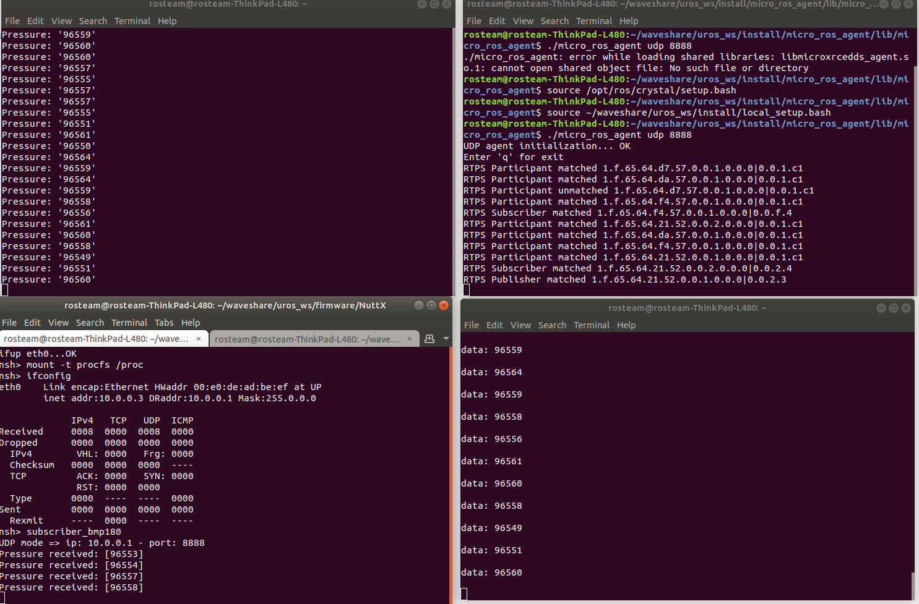
Real Time Results
Using 1 agent for 2 clients(boards) through same ethernet udp IPv4 connection (Linux not RT yet):
Built in publisher-subscriber not working even when 2 different ports or 2 agents are used with ethernet
my bmp180 publisher and subscriber are working on 2 different boards, but the subscriber is very slow in printing the received pressure values and also misses the values in between and later shuts down with error client unknown
Notes:
Hinterlasse hier Informationen zum Inhalt. So können auch andere diese Folie besser verstehen.
Hier steht ein Text zum Inhalt.

Slide 18
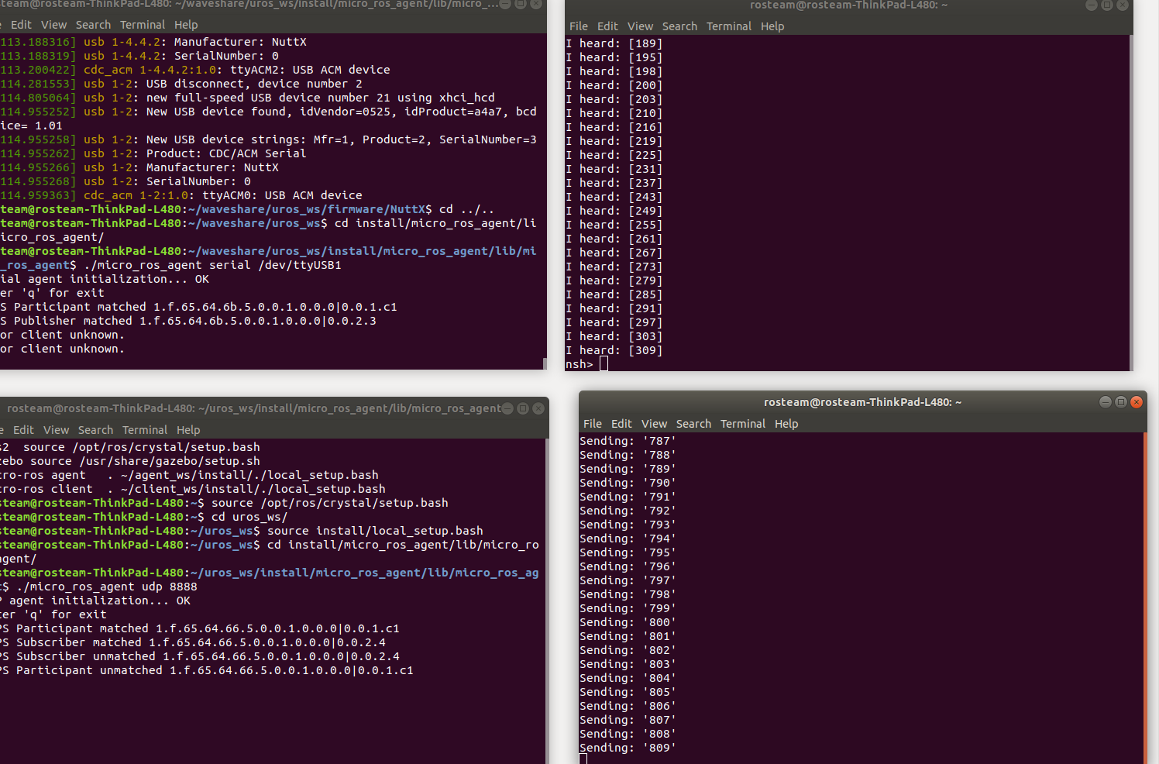
Real Time Results
Using 2 agent for 2 clients(boards) through 1 serial and 1 ethernet udp IPv4 connection (Linux not RT yet):
Publisher-subscriber works for a while and shuts down
Performance seems better: more data received and fast, but still misses some values
Notes:
Hinterlasse hier Informationen zum Inhalt. So können auch andere diese Folie besser verstehen.
Hier steht ein Text zum Inhalt.

